Slide 1

Patterns and Best Practices for dynamic OSGi Applications
Kai Tödter, Siemens Corporate Technology
Gerd Wütherich
Martin Lippert, akquinet it-agile GmbH

Slide 2
Agenda
Dynamic OSGi applications
Basics
Package dependencies
Service dependencies
OSGi Design Techniques
The Whiteboard Pattern
The Extender Pattern
Conclusion

Slide 3
"Classic" Java applications
Java Standard Edition:
Linear global class path
Only one version of every library per application
No component nor module concept above the classes level
Totally different deployment models for different kind of environments
Java Enterprise Edition:
Hot deployment possible, but requires special deployment types (e.g. WARs, RARs, EARs)

Slide 4

OSGi is dynamic!

Slide 5
Dynamic OSGi applications
Deployment unit:
Bundle = JAR + additional manifest headers
Supports dynamic scenarios (during runtime)
Update
Installation
Deinstallation

Slide 6
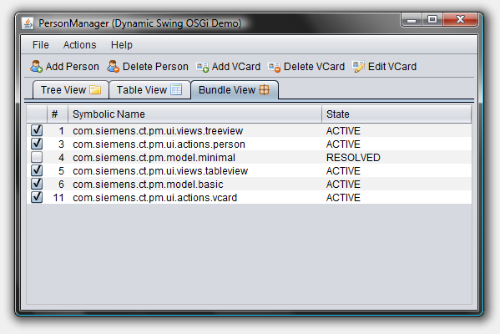
Dynamic Swing OSGi Demo

Slide 7
How to get the Demo?
The PM Demo project home page is: http://max-server.myftp.org/trac/pm
There you find
Wiki with some documentation
Anonymous Subversion access
Trac issue tracking
Licenses
All PM project sources are licensed under EPL
Swing Application Framework (JSR 296) implementation is licensed under LGPL
Swing Worker is licensed under LGPL
The nice icons from FamFamFam are licensed under the Creative Commons Attribution 2.5 License.

Slide 8
The first impressions
"Wow - OSGi does dynamic install, uninstall and update of bundles, this is cool…"
I don’t need to take care of dynamics anymore
I don’t need to think about this at all
Everything is done automatically under the hood
Objects are changed/migrated and references to objects are managed all automatically
Huge bulk of magic
This is all wrong!!!

Slide 9
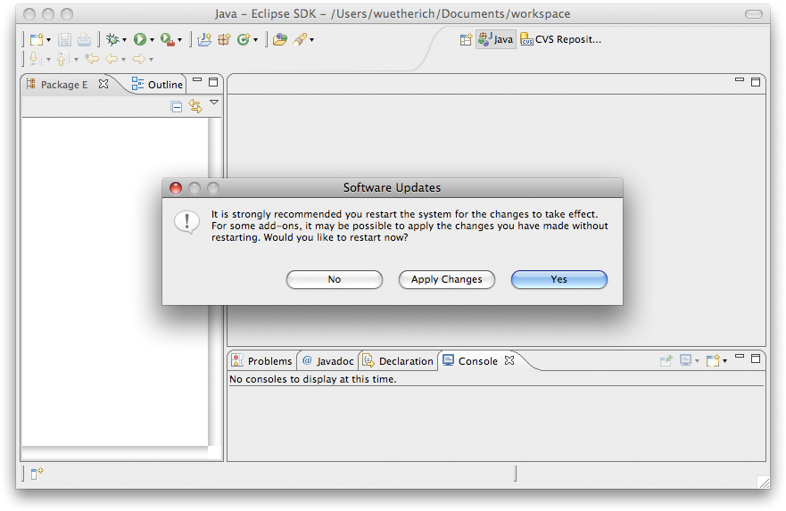
If its all magic, why this?

Slide 10
The basic idea
OSGi controls the lifecycle of bundles
It allows you to install, uninstall and update bundles at runtime
It gives you feedback on all those actions
But it does not change any objects or references for you
"No magic"
OSGi gives you the power to implement dynamic applications
How you use this power is up to you

Slide 11
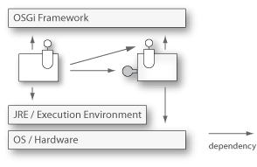
What is the problem?
Bundles have dependencies, e.g. package or service dependencies
Dependencies have to be handled with respect to the dynamic behavior!

Slide 12
Agenda
Dynamic OSGi applications
Basics
Package dependencies
Service dependencies
OSGi Design Techniques
The Whiteboard Pattern
The Extender Pattern
Conclusion

Slide 13
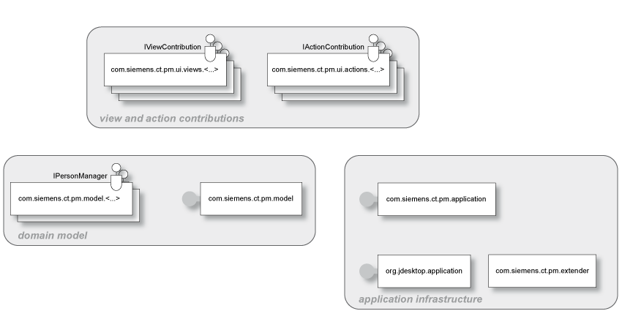
System overview

Slide 14
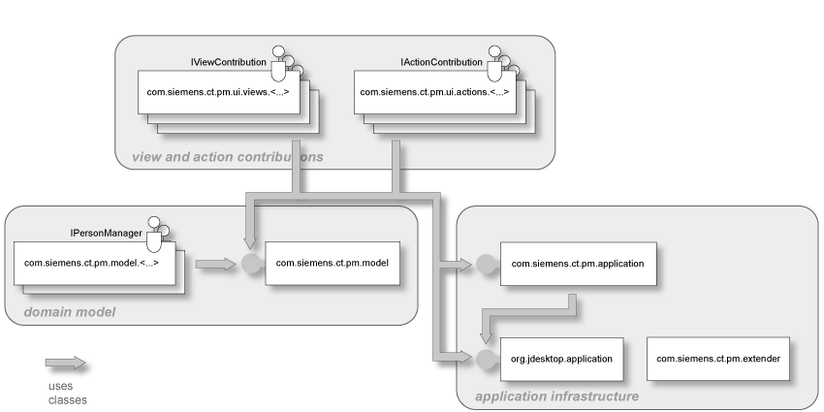
Package Dependencies
Export of packages with Export-Package
Import of packages via Import-Package or Require-Bundle

Slide 15
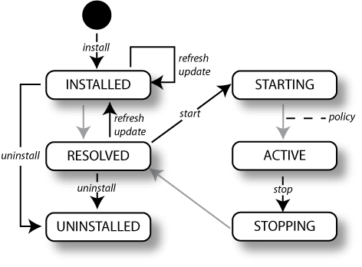
Digression: Bundle-Lifecycle
Bundles have a well defined lifecycle

Slide 16
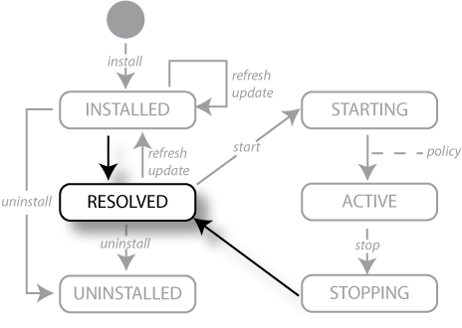
Resolving Package Dependencies
Wires bundles by matching imports to exports
Resolving may occur eagerly (after installation) or lazily
There is no API for resolving
After resolving -> Bundle is in state RESOLVED

Slide 17
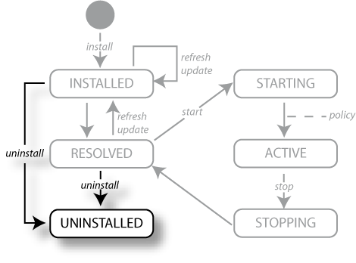
Uninstall
… removes a Bundle from the OSGi Framework
The Bundle State is set to UNINSTALLED
If the Bundle is an exporter: Existing wires will remain until
the importers are refreshed or
the OSGi Framework is restarted

Slide 18
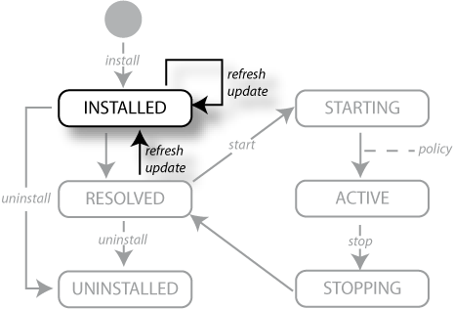
Update and Refresh
Update:
Reads in the Bundle again
If the Bundle is an exporter: Existing wires will remain until the importers are refreshed or the OSGi Framework is restarted
Refresh:
All the bundle dependencies will be resolved again

Slide 19
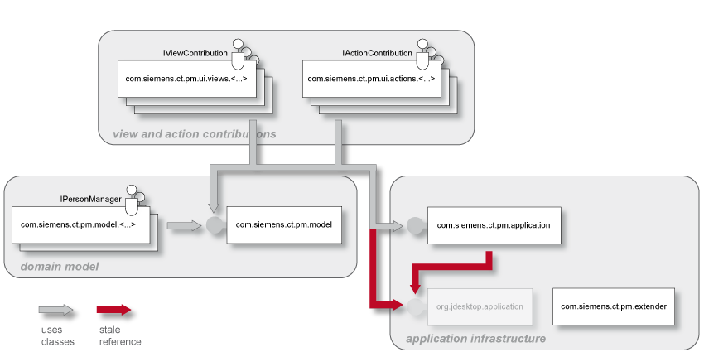
What does this mean?
Update or uninstall of bundles can lead to stale package references
Refresh -> restart of the bundles

Slide 20
We need to re-think designs
Just modularizing into bundles with clearly defined package dependencies is not enough!
We need to think about dynamics while building the system
We need to think even more about dependencies
We need to re-think typical well-known designs
More will follow

Slide 21
Best Practices: Package Dependencies
Only import packages that are really used/needed
Use Import-Package rather Require-Bundle
Only use Require-Bundle when it comes to split-packages
This is the unfortunately the case in many bundles of the Eclipse platform!
-> Reduce coupling

Slide 22
Agenda
Dynamic OSGi applications
Basics
Package dependencies
Service dependencies
OSGi Design Techniques
The Whiteboard Pattern
The Extender Pattern
Conclusion

Slide 23
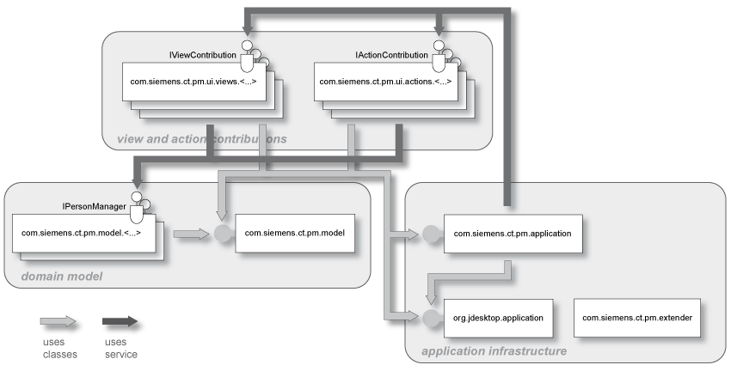
Service dependencies
One way to reduce coupling
Split interface and implementation into different bundles
Lookup implementation(s) dynamically

Slide 24
ServiceListener / ServiceTracker
But be careful:
If you lookup a service implementation, you get the direct reference to that object
If the implementing bundle goes away, you need to be careful not to keep this object referenced
ServiceListener / ServiceTracker help you
ServiceListener: calls you back if something changes
ServiceTracker: listens to service listener events for you (less code than using service listeners manually)

Slide 25
Declarative Approaches
Declarative Services
Part of the OSGi specification, declarative description of services with XML
Spring Dynamic Modules
Spring goes dynamic with help of OSGi
http://www.springframework.org/osgi
iPojo
“Original” DI framework for OSGi
http://ipojo.org
Guice - Peaberry
Guice: Performant, lightweight DI Framework
Peaberry: Extension of Guice for OSGi
http://code.google.com/p/peaberry/
http://code.google.com/p/google-guice/

Slide 26
Declarative Services (DS)
DS is part of the OSGi R4 spec
DS let you declare components in xml
The declarations live in OSGI-INF/<component>.xml
Components can provide services
Components can depend on other services
Uses dependency injection for references to other services:
These services are bound to defined bind/unbind methods in the components
A cardinality and a creation policy can be defined

Slide 27
PM Example DS Component
<component name="pm.ui.actions.person.ActionContribution">
<implementation
class="pm.ui.actions.person.ActionContribution"/>
<service>
<provide interface= "pm.application.service.IActionContribution"/>
</service>
<reference name="PersonManager"
interface="pm.model.IPersonManager"
bind="setPersonManager"
unbind="removePersonManager"
cardinality="0..1"
policy="dynamic"/>
</component>

Slide 28
Spring Dynamic Modules (DM)
Integration of Spring and OSGi
Implemented using Extender pattern
XML files live in META-INF/spring
Best Practice: Two XML files
One to define a Spring bean
One to map this bean to an OSGi service
Uses Spring dependency injection for references to other services
Similar but more flexible/powerful approach compared to DS
But needs 15 additional Spring and logging bundles to run

Slide 29
PM Example Spring DM Component
XML for Spring Bean:
<beans (Schema attributes omitted)>
<bean name="savePerson"
class="pm.ui.actions.save.ActionContribution"/>
</beans>
XML for OSGi service mapping:
<beans (Schema attributes omitted)>
<osgi:service id="savePersonOSGi" ref="savePerson" interface="pm.application.service.IActionContribution"/>
</beans>

Slide 30
Best Practices: Services
Use a ServiceTracker
Don’t do all the service getting manually
Service tracker help you with dynamically coming and going services
Better: Use declarative approaches!
Either DS or Spring DM
Both help you with service dependencies and dependency injection

Slide 31
Agenda
Dynamic OSGi applications
Basics
Package dependencies
Service dependencies
OSGi Design Techniques
The Whiteboard Pattern
The Extender Pattern
Outlook: Architectures for dynamic Systems
Conclusion

Slide 32
The Whiteboard-Pattern
Problem: Often a service provides an implementation of the publisher/subscriber design pattern and provides methods to register listeners for notifications
The OSGi service model provides a service registry with these notification mechanisms already!
So:
Don’t get a service and register as listener
Be a service yourself and register with the OSGi service registry!

Slide 33
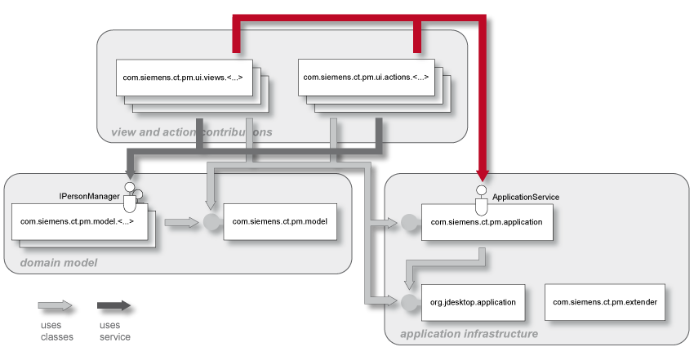
Example: The Listener Pattern
Clients use ApplicationService to register view and action contributions
Client is responsible for handling dynamic behavior

Slide 34

Example: The Whiteboard Pattern
Clients register view and action contributions as services
Application manager is responsible for handling dynamic behavior

Slide 35
Whiteboard Pattern in PM Demo
The Action and View contribution managers are NOT services
Instead, they are wrapped in a DS component
All action and view contributions are OSGi services and implement
IActionContribution
IViewContribution
Take a look at the bundles
com.siemens.ct.pm.application
com.siemens.ct.pm.ui.actions.*
com.siemens.ct.pm.ui.views.*

Slide 36
Agenda
Dynamic OSGi applications
Basics
Package dependencies
Service dependencies
OSGi Design Techniques
The Whiteboard Pattern
The Extender Pattern
Conclusion

Slide 37
The Extender Pattern
The extender pattern allows bundles to extend the functionality in a specific domain
It uses the synchronous bundle listener
The extender adds a bundle listener to the BundleContext
The bundle listener overwrites public void bundleChanged(BundleEvent event)
Then the listener checks the started bundle for a specific handler and performs some (domain)specific action
The extender should also check all already started bundles in its activator

Slide 38
PM Demo Extender: Registering Services
The following example shows a demo extender
Implemented in com.siemens.ct.pm.extender
Registers a bundle listener
Looks for the manifest header "Action-Contribution" in every bundle
When found in a started bundle
Parses the value as class name
Registers the class as service implementation for com.siemens.ct.pm.application.service.IActionContribution
When found in a stopped bundle
Unregisters the service

Slide 39
PM Demo Extender (1)
public class Activator implements BundleActivator, SynchronousBundleListener {
public void start(BundleContext context) throws Exception {
context.addBundleListener(this);
// search for existing bundles
Bundle[] bundles = context.getBundles();
for (Bundle bundle : bundles) {
if (Bundle.ACTIVE == bundle.getState()) {
greet(bundle);
}
}
}

Slide 40
PM Demo Extender (2)
public void stop(BundleContext context) throws Exception {
context.removeBundleListener(this);
}
// React on bundle events
public void bundleChanged(BundleEvent event) {
if (BundleEvent.STARTED == event.getType()) {
addService(event.getBundle());
} else if (BundleEvent.STOPPED == event.getType()) {
removeService(event.getBundle());
}
}

Slide 41
PM Demo Extender (3)
private void addService(Bundle bundle) {
String className =
(String) bundle.getHeaders().get("Action-Contribution");
try {
if (className != null) {
Class clazz = bundle.loadClass(className);
ServiceRegistration serviceRegistration =
context.registerService("pm.service.IActionContribution",
clazz.newInstance(), null);
serviceMap.put(bundle.getSymbolicName(),
serviceRegistration);
} catch (Exception e) {
// Catch all Exceptions
}
}
}

Slide 42
PM Demo Extender (4)
private void removeService(Bundle bundle) {
ServiceRegistration serviceRegistration =
serviceMap.remove(bundle.getSymbolicName());
if (serviceRegistration != null) {
serviceRegistration.unregister();
}
}

Slide 43

Discussion

